Slide 1

Implementation of RISC-V Processor
Yuval Salti – 318597945
Maor Elbaz – 208418293
Supervisor: Dr. Avihai Aharon

Slide 2
Project Goals
Objective:
To design and implement the RISC-V Processor and to explore various methods in order to determine the best performance and most reliability.
The project includes:
Softcore processor on Artix-7 FPGA.
Assembly programs that runs on the softcore.
Support for RV32I and RV32M extension.
Notes:
The project goal was to research and explore the open-source RISC-V architecture and to design and implement it as a soft-core on an FPGA using different methods in order to determine which one has the best performance and is the most reliable.
This project includes a soft-core RV32IM on Artix-7 FPGA.
As well as 6 different assembly programs that run on the softcore.

Slide 3
Theoretical Background
Background
RISC-V ISA
Formats
ABI
Extensions
Architecture approaches
Notes:
RISC-V Instruction Set Architecture is a modern, open-source and modular architecture. It was created in the parallel lab in Barkly university and was created in order to provide free and scalable ISA that support wide range of fields.
RISC-V ISA operate according to RISC philosophy – that is use of smallest of simple instructions where each instruction perform only one operation.
In RISC-V there are 6 different formats:
R-type – for arithmetic and logical operations between two registers.
I-type – for arithmetic and logical operations with an immediate, loads, jumps and system calls.
S-type – for store operations.
B-type – for conditional jumps.
U-type – for upper immediate operations.
J-type – for jumps.
ABI defines how the binary code communicate with the operating system. It determine:
The registers names and their role.
Which registers are saved by the callee or caller.
Which arguments are supposed to be passed to a function and restored on each stage.
As stated, RISC-V is a modular architecture which means you can implement what extensions you want to use according to your system needs.
There are many extensions in the RISC-V architecture, some of them are:
M – for multiplication and division operations.
C – for compressed instructions.
F/D – for single and double precision floating point.
A – atomic operations.
There are many approaches to implement a RISC-V processor including: single cycle, multi cycle, pipelined (3,5 or 7), superscalar and many more.
In this project we chose to implement the first 3.
לדבר על מתי נוצר ואיפה.
להסביר בקצרה מזה ISA וואיך קשור.
להסביר בקצרה על הפורמטים השונים R S U I B J
הסבר ABI
הסבר על חלק מההרחבות הקיימות M C וכו
הסבר קצר על SINGLE MULTI PIPELINED

Slide 4
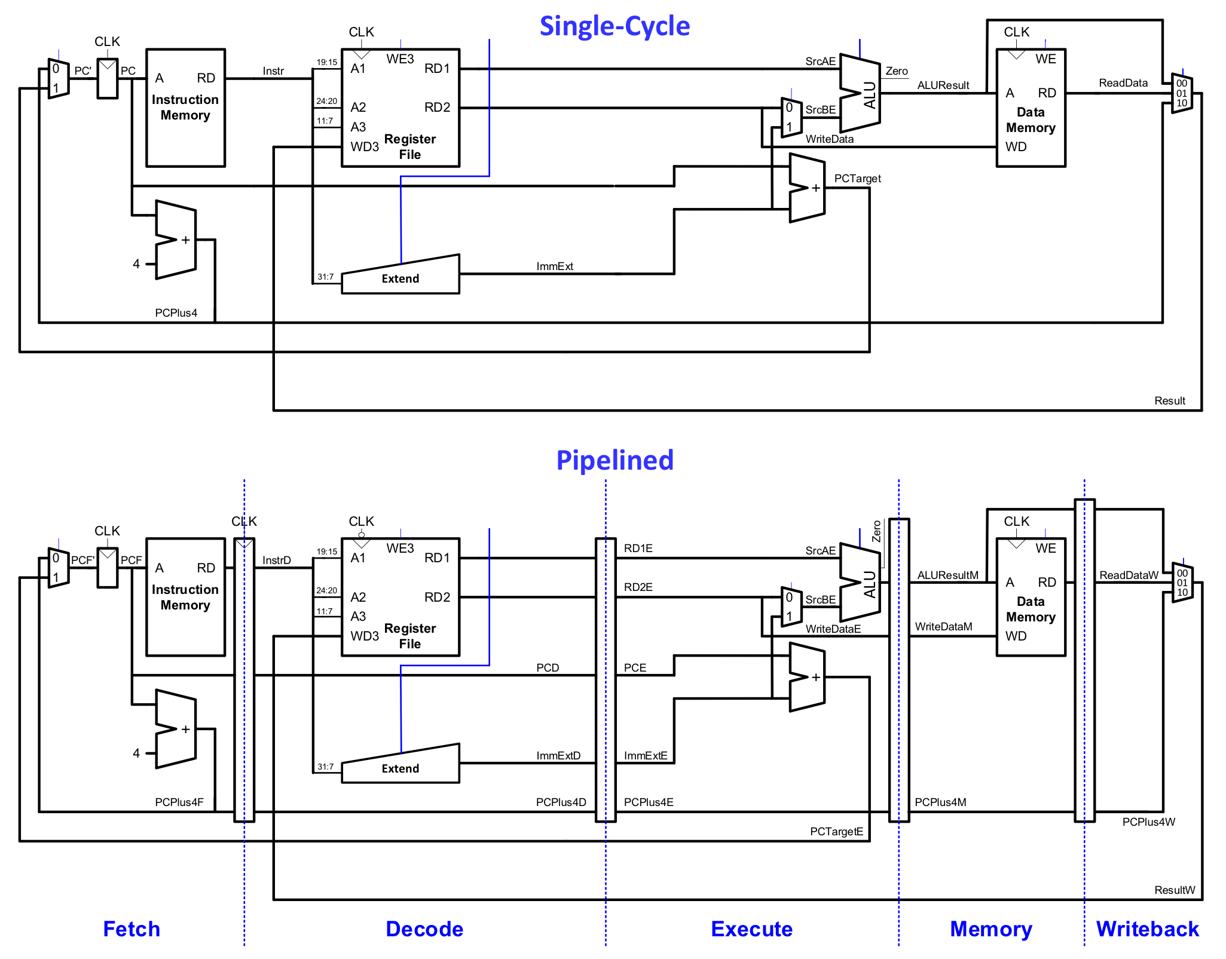
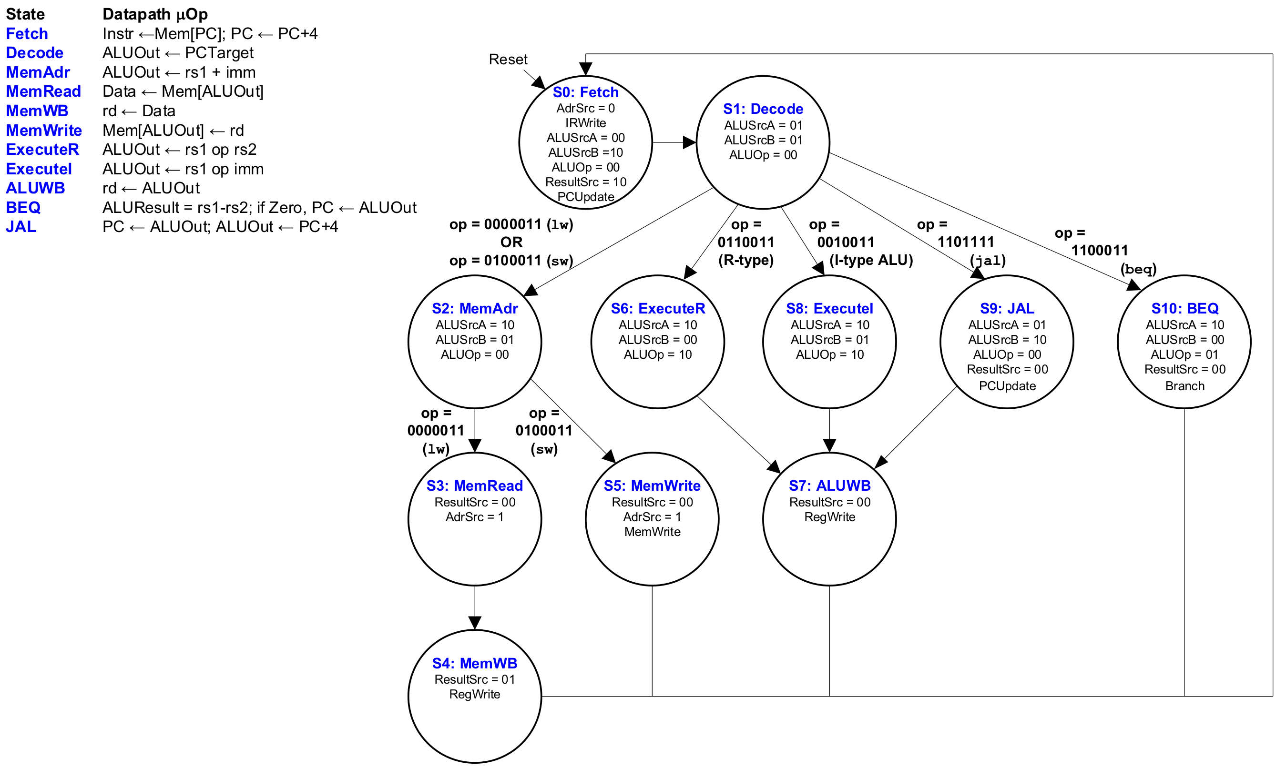
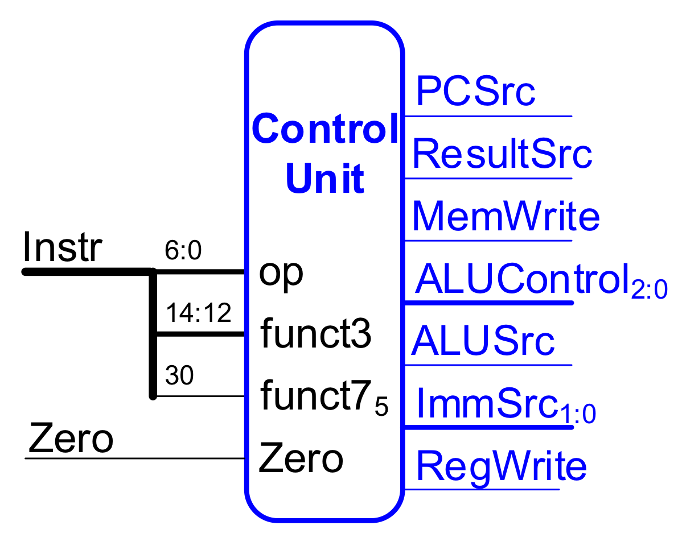
Theoretical Background
Notes:
There are many components in a RISC-V processors the main ones are: PC register, instruction memory, RF, extend unit, ALU and data memory.
How they are connected between them determine approach.
In the first picture we can see the single cycle vs the pipelined structures. They differ from each other in that that the pipelined is a processor with stage registers between the different stages and each instruction spans across few cycles in contrast to the single cycle that each instruction is occupying only one cycle but its cycle is much slower then the pipelined.
Each of the implemented approaches is divided into two sections: the Datapath and the control unit.
Datapath hold all the components of the processor that responsible for executing what the instruction needs.
The control unit is responsible for making sure that only the needed components in the Datapath are activated when they are needed in order for the instruction to execute correctly.
When researching the multi cycle approach, we decided that the best way to implement the control unit is with a state machine that flows between different states that determine the control signal for each cycle needed.
הסבר קצרצר על ההבדל בין PIPELINED ל SINGLE (תמונ שמאל)
סבר על DATAPATH ו יחידת בקרה (תמונה שמאל ותמונה תחתונה)
הסבר על ביצוע מכונת מצבים ביחידת הבקרה של ה MULTI

Slide 5
Work Stages and Challenges
Design
Simulation
Synthesis
Implementation
Bitstream Generation
Design –
Challenge: designing fast and reliable processor yet according to the RISC-V guidelines.
Simulation –
Challenge: finding an efficient and simple way to make debugging process easier.
Synthesis –
Challenge: understanding to what the design is translated to.
Implementation –
Challenge: learning about the structure of the FPGA and how the design is mapped.
Bitstream Generation –
Challenge: becoming familiar with the design suit.
Notes:
when we decided to work with FPGA there is a certain design flow we had to follow.
First of all is the Design. We had to plan and describe our processor. According to that we programed in System Verilog all the modules and defined all the inputs and outputs of the system. In the end of the stage, we had a RTL design of our Processor.
Next in line is the Simulation. In this stage we needed to verify the design we created. We wrote 6 programs to test all instructions and behaviors of the processor. All program ran on the processor through a dedicated testbench. We created a HASH code that helped us shorten the time needed to tell if the system worked or not instant.
The third stage is Synthesis. In this stage we used the built in tools in Vivado to convert our SV code into a hardware netlist.
The fourth stage is the Implementation. In this stage we uses Vivado tools to physicly map and connect the synthesized design inside our FPGA. By this stage we already have a placed and routed design and diagram of how it will look.
The last stage after we designed verified and implemented out device is to generate a bitstream and program it on the FPGA. After that we will be able to see and control on the FPGA.
הסבר על שלבי הפיתוח בעבור FPGA
עיצוב
סימולצה
סינתזה
אימפלימנטציה
וצריבה על ה FPGA

Slide 6
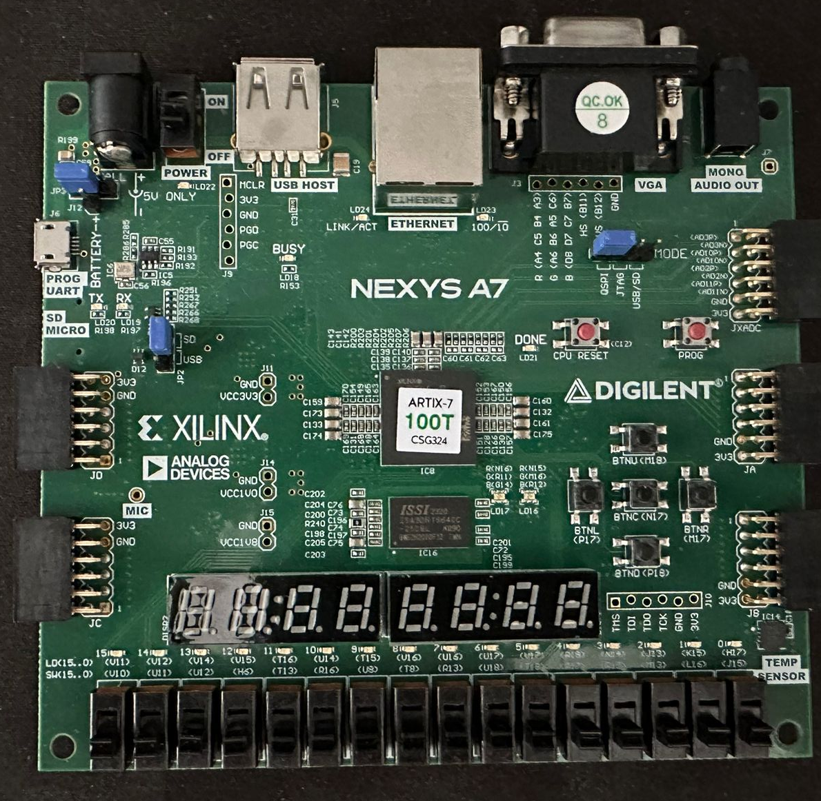
Project Deliverables
Deliverables:
Fully functional RV32IM softcore Processor in System Verilog on an FPGA.
Implemented In 3 different methods: Single Cycle, Multi Cycle and Pipelined.
6 different assembly codes to machine codes files that run on the FPGA through BRAM blocks.
Notes:
In the end of the project, we had in our hand a functioning RV32IM Processor which was program in system Verilog.
We implemented the processor various ways including: Single cycle, Multi Cycle and Pipelined. This choice allowed us to gain full understanding of RISC-V and Computer Architecture.
We also wrote 6 different assembly code which we later translated to Machine code. These files were used in the simulation to check the Processor and were programed into the BRAM of the FPGA to see that it works there as well.

Slide 7
Project Deliverables
Challenges:
M-Unit:
Designing M-UNIT in the RV32M processor that
follows RISC-V guidelines while working in time
with the different processors types
Complex Architecture Design:
Designing Hazard UNIT for the Pipelined
Processor to solve data and control hazards
7 SEG and timing:
Building dedicated driver for the 7-Segment display and frequency divider so we can clearly
see the results on the FPGA
Hash Calculation:
The transition from implementing HASH in
testbench to top level module
Notes:
We had few challenges throughout our project.
When working on the pipelined processor we needed to design a hazard unit that will solve several problems that may occur while it runs.
Some of the problems are data and control hazards.
Data hazards may occur when data that is needed in a following instruction is yet to be updated in the register file. We solved this problem by forwarding the data from the first instruction to the instruction that needed the data before it written back into the register file.
Another data hazard we had to solve is LW-dependency. Which occur when we load a data from memory is needed in a following instruction that is in the execute stage. We solve it by stalling our first two stage registers and flushing our execute register.
The third hazard is a control hazard which occur when we are in a conditional branch instruction which is yet to decide where to jump. When the jump is not to the next instruction a hazard occur because we already started the following instructions but need to jump to a different location in the program. This hazard is solved by flushing our IF and ID stage registers.
The second problem we had is with the M-Unit. We needed to create the different operations exactly according to the RISC-V guidelines. The problem was to integrate this unit flawlessly into the existing RV32I Processor without compromising the other instructions that already work or the different modules that are affected.(קושי לשלב יחידת חישוב חדשה שמבצעת פעולות כבודת יותר מבלי לשבור את שאר המעבד שפועל כבר בצורה תקינה , כלומר לשמור על תאימות לRV32I (
When getting into the final stages of the RISC-V Project we needed to design a driver for the 7 segments display as well as a frequency divider in order for our eye to see and process the data which is presented instead of it going in speeds that out eyes can comprehend.
The last challenge we had is in the simulation and after programing the FPGA. We needed a fast and reliable way to tell if the Processor we checked is working according to one of the 6 programs we ran on it. Therefore, we created a HASH code for each program the calculate according to live data if the program ran correctly or not. This method saved us a lot of time as we didn’t need to check the waveform and registers values throughout the program.

Slide 8
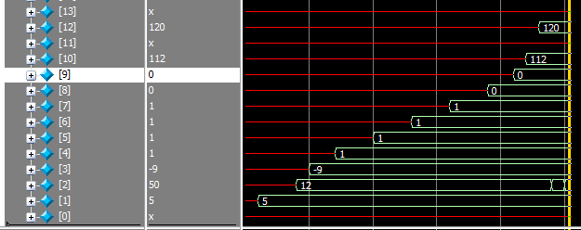
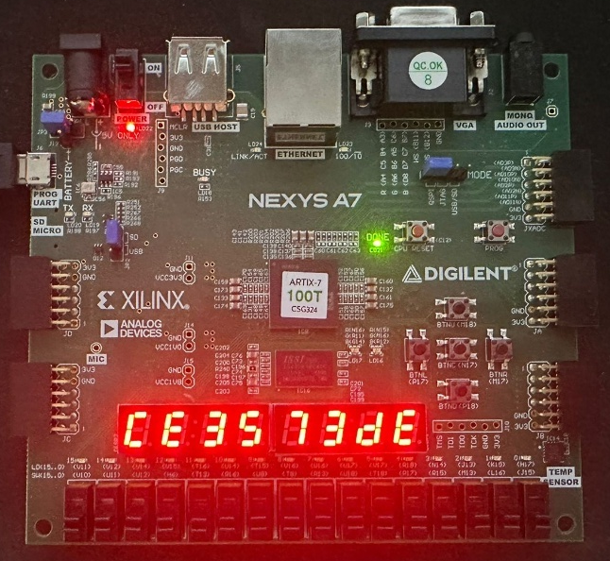
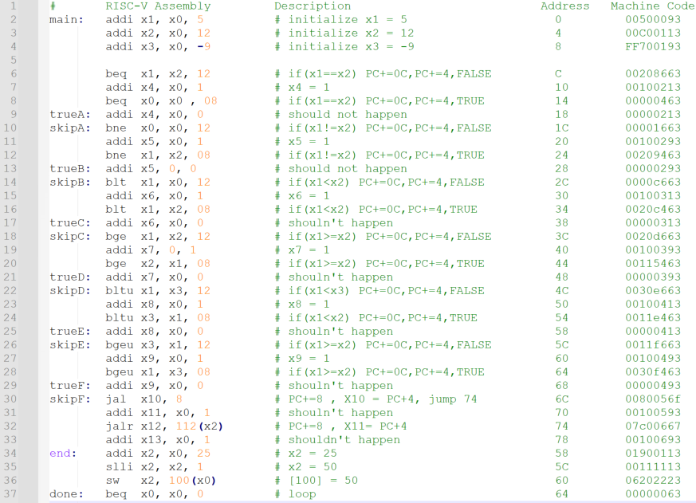
Results / Demonstration
We Wrote a 6 different programs that runs on the FPGA Soft-core.
The following screenshots are of the Branch Test
The following video show demonstration of the math calculation test from RTL through simulation all the way to the programing of the FPGA:

Slide 9
Results Analysis / Conclusions
Adding support for peripherals
Creating a working assembler
Optimizing the CPU
Implementing more extensions of RISC-V
Notes:
Adding support for peripherals to control the CPU and show more of its capabilities.
Create and connect a working assembler for the RISV-V Processor.
Optimize algorithms embedded in the CPU and saving on resources, essentially making the CPU even faster.
Implementing more extensions of RISC-V to extended the PROCESSOR capabilities.

Slide 10
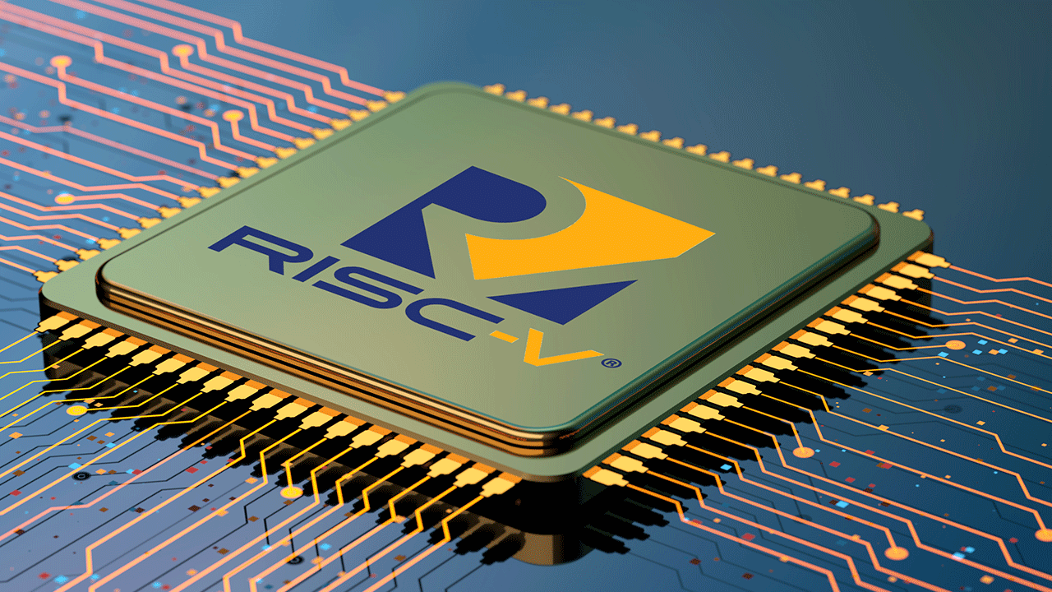
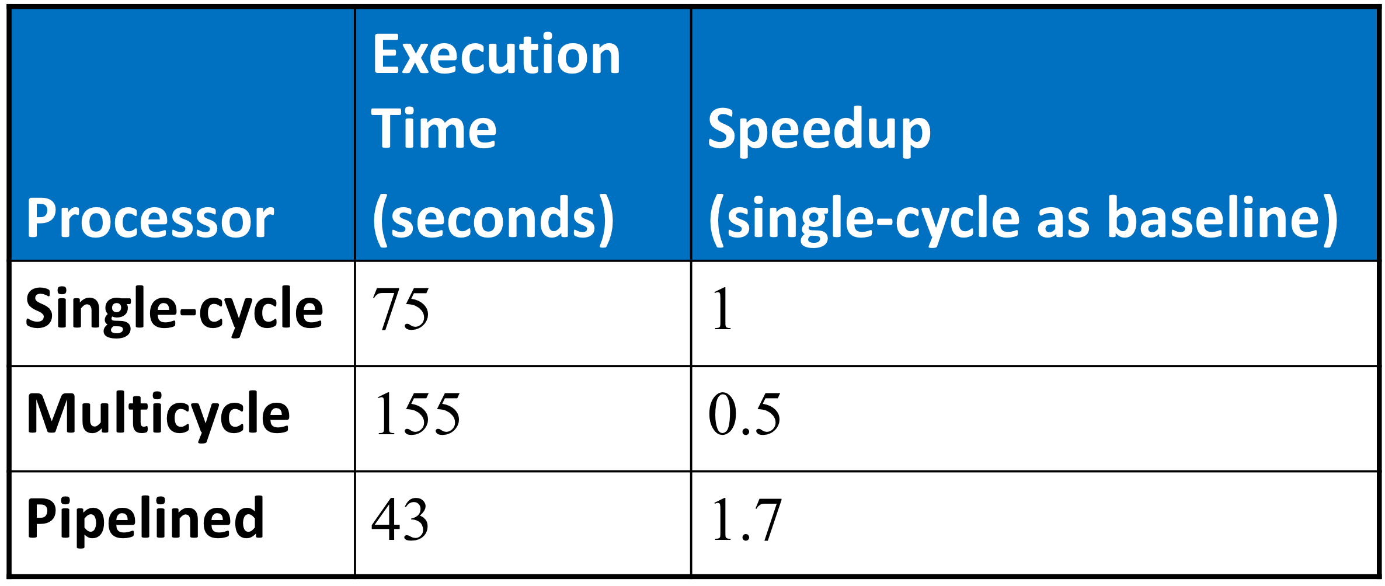
Recommendation for development / Research
Fast and Reliable RISC-V Soft-Core
Definite proof for superiority of Pipelined on Single cycle and Multi cycle.
Notes:
We created a working RISC-V Soft-core that is fast and reliable executing all instructions correctly and according to the RISC-V guideline.
We also provided definite proof for superiority of Pipelined on Single cycle and Multi cycle when looking at it from an execution time stand point.
However, the pipelined took more resources when implemented from the other two which correspond with what we opredicted.

